Slide 1
Artificial Intelligence
Enrique Peláez Ph.D.

Slide 2
Agenda
  Machine Learning
    Neural Networks
    Genetic Algorithms
  Applications

Slide 3
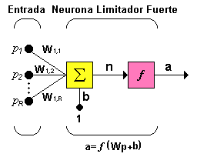
Neural Networks
Network Topology: Typically a neuron has more than one input.
Individual inputs p₁,p₂,...,p_{R} are multiplied by the corresponding weights w_{1,1}, w_{1,2},...w_{1,R} as established in the weight matrix W

Slide 4
Neural Networks
The neuron has a gain value b, that feeds the sum of the other inputs multiplied by the weights, to compose the output n
The sub indexes of the weight matrix represent the elements involved in the connection; the first sub index represents the destine neuron, and the second represents the origin of the signal that feeds the neuron.
For example, the indexes of w_{1,2} say… this weigh w, is from the second input of the first neuron. This convention is useful when there is more than one neuron, or when there are neurons with many parameters.

Slide 5
Neural Networks
In a neural net the processing elements are grouped as layers. A layer is a collection of neurons, and based on the location of the layer, it receives a different name:
  Input layer: Receives the signals from the input of the network, some authors do not consider this as a layer, but a input vector, because in this layer there is not any processing.
  Hidden layer(s): This layers do not have any contact with the outside, their elements can have many different connections and it is in this layer that determine the topology of the network.
  Output layer: Receives the information from the hidden layer and transmits the result to the outside.

Slide 6
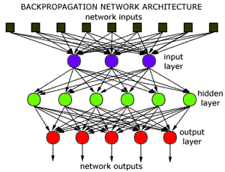
Neural Networks

Slide 7
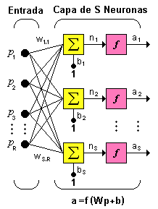
Neural Networks

Slide 8
Neural Networks
One layer network with S neurons, each one of the R inputs is connected to each of the S neurons, the weight matrix has now S rows.

Slide 9
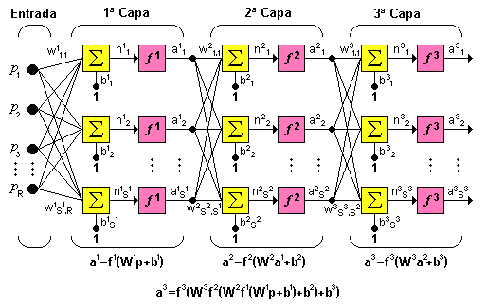
Neural Networks

Slide 10
Neural Networks
Structures
I
NPUT
OUT
PUT
Σ
Algorithmic
component
Neuron
Layer
Net
Neural System
Notes:
Cada neurona realiza una función matemática.
Las neuronas se agrupan en capas, constituyendo una red neuronal.
Una determinada red neuronal está confeccionada y entrenada para llevar a cabo una labor específica. Finalmente, una o varias redes, más las interfaces con el entorno, conforman el sistema global.

Slide 11
Neural Networks
Weights
  Neural nets can have fixed and adaptable weights.
  Neural nets with adaptable weights use learning laws to adjust the values of the connection with other neurons.
  In neural nets where the weights are fixed, the tasks are previously defined.
  Weights are determined based on the complete description of the problem.
  Adaptable weights are essential, when the best weights are unknown.

Slide 12
Neural Networks
Learning types: There are 2 types of learning: Supervised and Not supervised.
  Supervised: Occurs when the expected input and output are provided, hence the net adjusts its weights trying to minimized the output error.
    This type of training is applied for example in pattern recognition.

Slide 13
Neural Networks
  Not supervised: Occurs when the inputs are the only stimuli provided, and the net adjusts the interconnections based on its outputs only.
    The learning laws determine how the network adjusts its weights, based on an error function.
    And, the appropriate learning law will be selected based on the nature of the problem to be solved.

Slide 14
Neural Networks
Training
  Training in the perceptron is based on a learning law, known as delta:
    For each weight W an adjustment is made based on a ΔW, and according to the following rule:
      ΔWj_{ji} = βY_{i} ( T_{j} - Y_{j} )
      Where:
      β is a learning factor, (0 < β ≤ 1) – sets the learning speed.
      Y_{i} output value from neuron i
      T_{j} wished value for neuron j,
      Y_{j} output value obtained at neuron j,

Slide 15
Neural Networks
Operation phases: Adaptable nets have 2 operation phases:
  Net training. The user provides an “adequate” number of stimuli at the entrance and exit of the network, then the net adjusts its interconnection weights or synapses until the output is “close enough” to the exit.
  Knowledge recovery. A set of stimuli is provided at the entrance and the net estimates the output. When the network uses not supervised training, sometimes it is necessary to adjust the synapses during the recovery or retrieval phase.

Slide 16
Neural Networks
Neural networks are not algorithmic
  One difference between neural nets and other systems is that NN are not algorithmic; that is, they are not programmed to follow a set of predefined sequence of instructions.
  Neural nets generate themselves their own rules to associate the output to the input. That is, the learn by example, and from their own mistakes.
  The knowledge, in a neural net, is located in the activation function and in the weight values assigned.

Slide 17
Neural Networks
NN have been used with success in a variety of fields:
  To recognize shapes based on sonar returns under the water,
  Hand writing, Voice,
  Land topography,
  Robot arm control,
  Evaluation of personal data,
  Cognitive modeling,
  To predict financial tendencies, among others.

Slide 18
Neural Networks
The kind of problems that NN resolve best are the kind of problems that humans also best resolve:
  Association, evaluation, pattern recognition.
  Problems that are difficult to calculate, but do not require exact answers, just good and quickly answers, such as:
    Stock market scenarios where we would like to know if “buy?”, “sell?”, “stay?”.
    Recognition, when we want to know “looks like?”, “it is the same but….”

Slide 19
Neural Networks
NN are not good for precise calculations, serial processing. They are not capable of recognizing anything, unless there is a pattern associated with it.
There are many ways to make connections in a NN, just like there are many ways the biological neurons connect in the brain.
Each kind serves a different purpose, electing the right topology and its characteristics in very important to reach a solution of the problem.

Slide 20
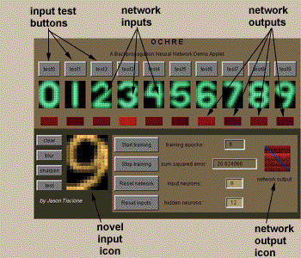
Neural Networks

Slide 21
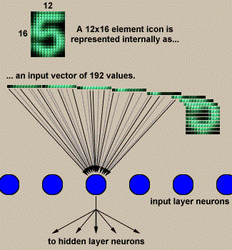
Neural Networks

